Slide 1
Predators and Prey What do animals eat? Aim: learners will understand the difference between predator and prey and what carnivores, herbivores and omnivores are. Learning Outcomes All: state verbally or write an example of at least one feature that distinguishes or identifies the difference between a carnivore, herbivore and omnivore. Most: describe with one or more examples features that distinguish or identify the difference between carnivores, herbivores and omnivores. Some: Explain two key features or more, that distinguish or identify the difference between carnivores, herbivores and omnivores.
NEXT SLIDE

Slide 2
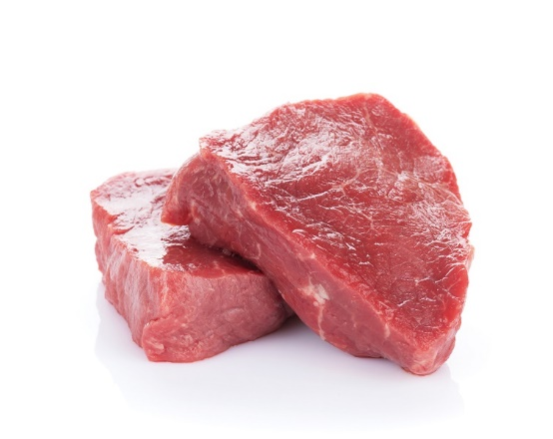
What do Animals Eat?
All animals need to eat to survive. Some animals are predators and eat meat. Do you know what these animals are called?
Answer

Slide 3
All animals need to eat to survive. Some animals are predators and eat meat. Do you know what these animals are called?
Animals that eat meat are called carnivores.
They are strong and fast so they can catch their prey.
NEXT SLIDE

Slide 4
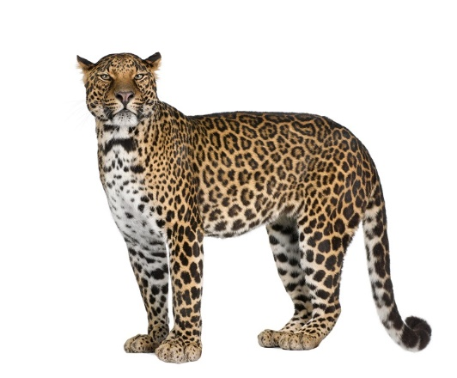
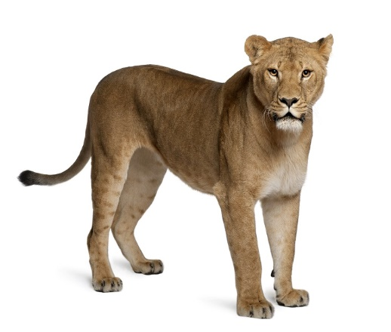
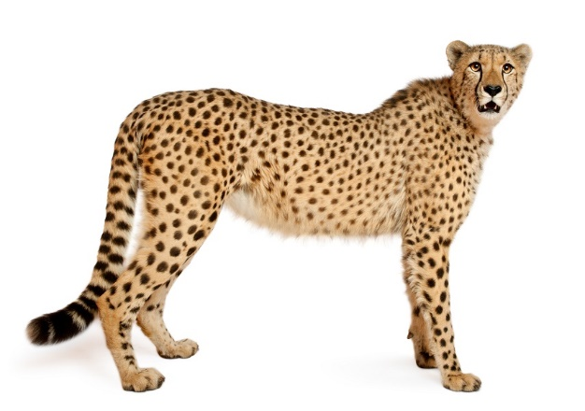
What do Carnivores Look Like?
Leopards, lions and cheetahs are carnivores. They are fast and strong so they can hunt and catch their prey. Very rarely, they might kill and eat each other.
Usually it would be each others’ cubs or ill and weak adults, or when they fight over territory.
NEXT SLIDE

Slide 5
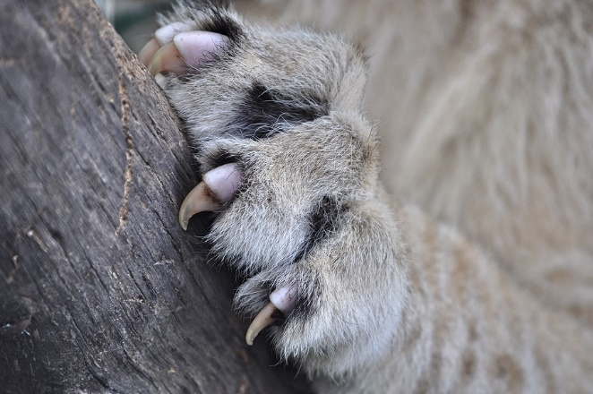
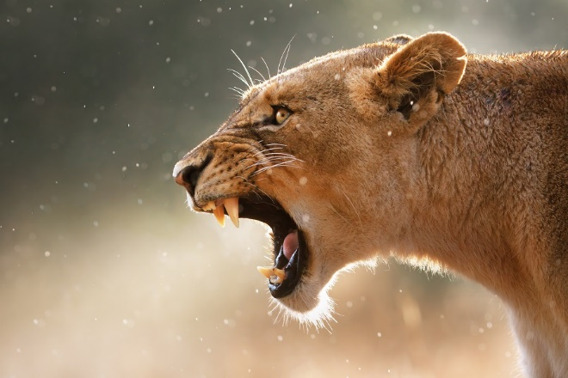
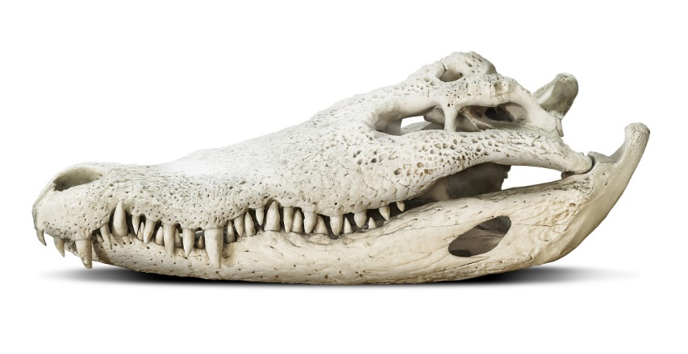
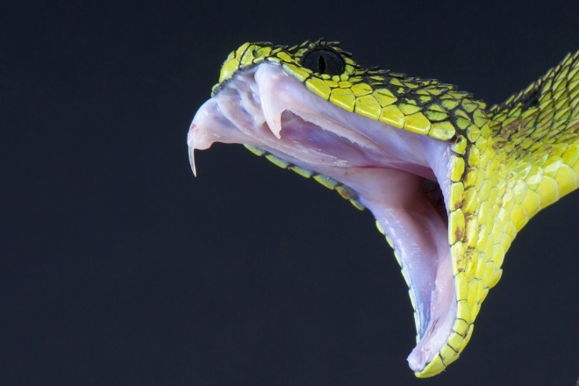
What things might a carnivore or predator have to help them eat and survive?
Sharp claws for gripping
Sharp teeth for tearing
Powerful jaws to drive teeth into skin and flesh
Some predators might have more than one of these features. Why would that be do you think?
Venom through fangs or stings
Powerful eyesight
NEXT SLIDE

Slide 6
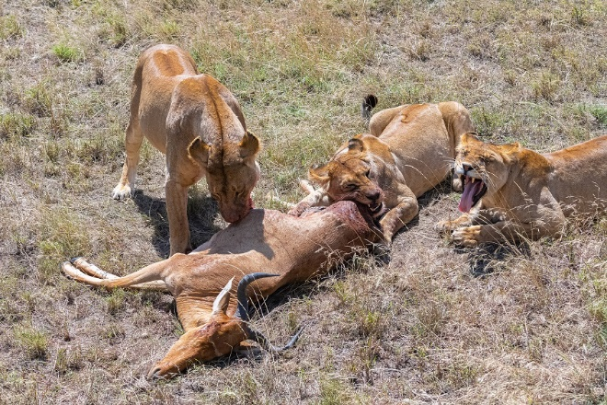
Lions have claws, good eyesight, a keen sense of smell, sharp claws, powerful legs, speed and strong jaws. All of these features make them efficient predators.
NEXT SLIDE

Slide 7
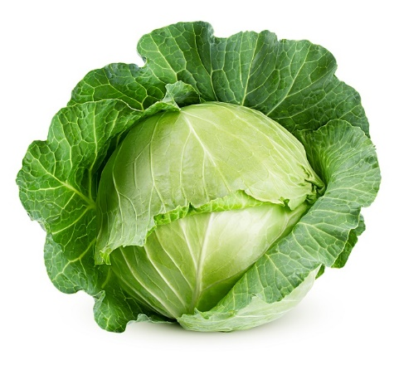
Some animals eat plants to survive. Do you know what these animals are called? A lot of them are prey animals and they are eaten by predators.
Answer

Slide 8
Some animals eat plants to survive. Do you know what these animals are called?
Animals that eat plants are called herbivores.
They can sometimes be strong and sometimes fast so they can escape predators.
NEXT SLIDE

Slide 9
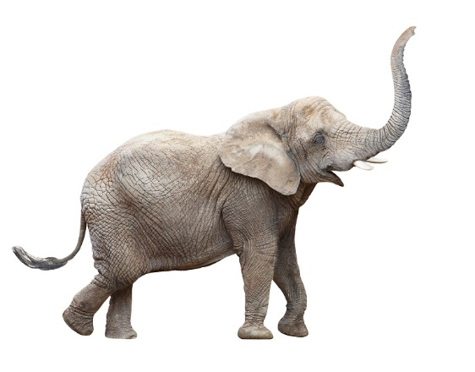
Herbivores’ teeth are flat and strong to help them grind the plants they eat.
This elephant’s teeth are so strong, it can grind up twigs and thin branches if it needs to.
NEXT SLIDE

Slide 10
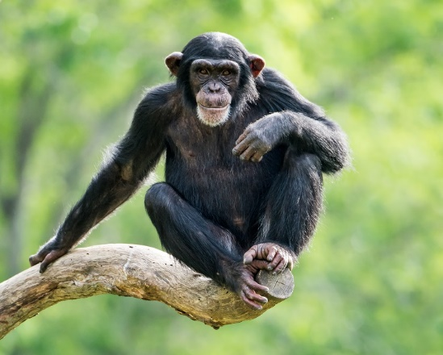
Some animals eat both meat and plants. What do we call these animals?
Answer

Slide 11
Some animals eat both meat and plants. What do we call these animals?
We call these animals OMNIVORES.
Sometimes they are fast and strong, just like the carnivores so they can catch their prey.
Chimpanzees eat plants, bark, fruit, insects, honey, and make hunting teams to catch and eat monkeys. Sometimes they will kill and eat members of rival troupes, and on rare occasions their own group members, too.
NEXT SLIDE
15/12/2021
Copyright Bugfest Ltd 2021

Slide 12
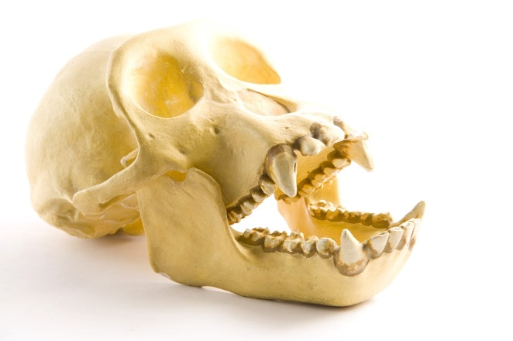
To cope with their varied diet, omnivores have a mixture of teeth. Sharp incisors for chopping and biting, and flat molars for grinding.
Sharp teeth (incisors)
In this chimp skull you can see the sharp teeth for tearing flesh and the grinding teeth for tougher plant materials.
Grinding teeth (molars)
NEXT SLIDE

Slide 13
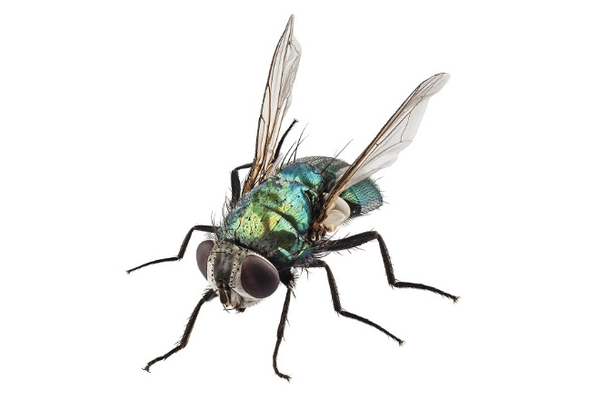
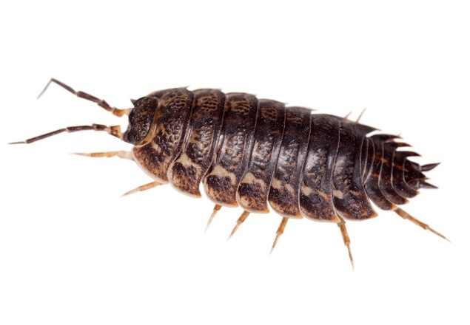
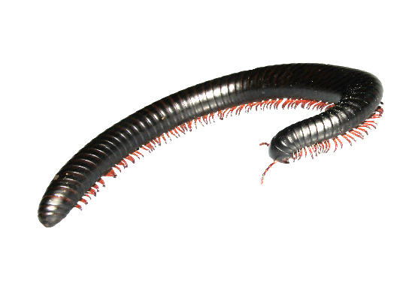
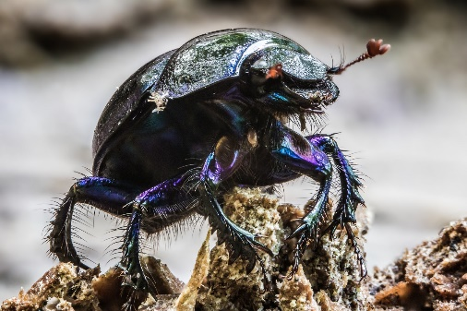
Some animals eat poo, dead or rotting meat and plants. What do we call these animals?
Answer

Slide 14
Some animals eat poo, dead or rotting meat and plants. What do we call these animals?
We call these animals DETRITIVORES.
Sometimes they are fast and strong, sometimes slow because they don’t need to chase their food.
Sometimes they have strong teeth like millipedes, sometimes no teeth like worms and maggots.
NEXT SLIDE

Slide 15
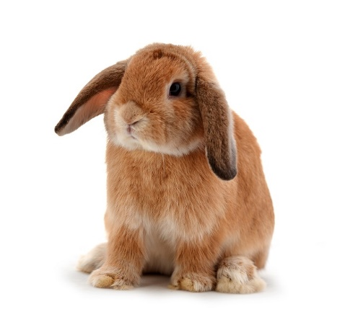
QUIZZ TIME
Look at these animals. Try to guess who is herbivore, carnivore or omnivore.
Say why you think they are what you say they are. Some are more tricky than you think because their babies eat different things.
Why don’t you keep a score on a whiteboard or sheet of paper and add your points up at the end?
You get a point for guessing right and a point for what you think they eat. Click on the animals to reveal the answer.
Carnivore
Herbivore
Omnivore
I eat meat at all stages of life
I eat plants at all stages of life
I eat plants and meat at all stages of life
NEXT SLIDE

Slide 16
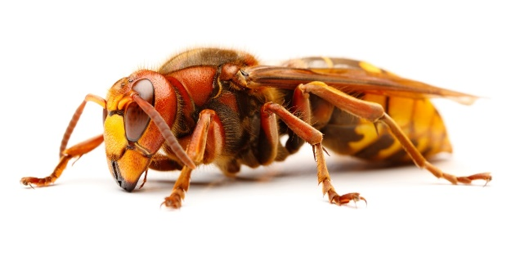
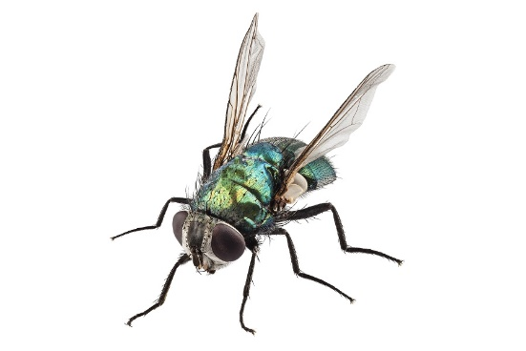
Carnivore
Omnivore
Detritivore
I eat meat at all stages of life
I eat sugars from flowers and tree sap, but my babies (larvae)only eat insects.
I eat sweet liquids from flowers and tree sap, rotting fruit, even poo juice, but my babies (maggots) eat rotting flesh.
NEXT SLIDE

Slide 17
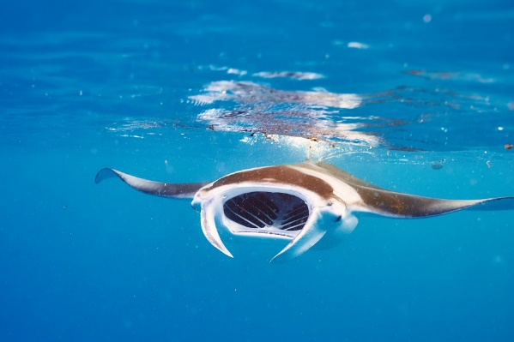
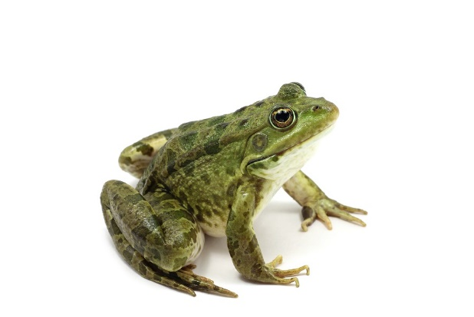
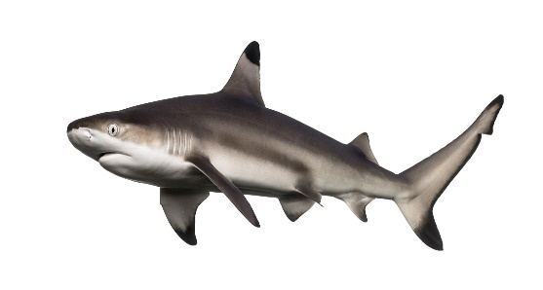
Omnivore
Carnivore
Carnivore
I eat algae, plankton, krill and very small creatures in sea water.
I eat fish, seals, and sometimes a silly human. But you are more likely to be killed by a toaster than me.
I eat flies, beetles, slugs and worms.
NEXT SLIDE

Slide 18
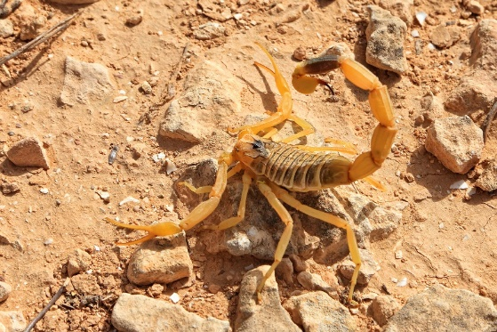
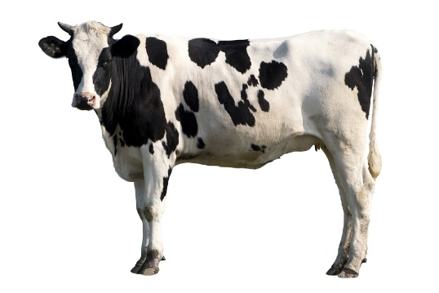
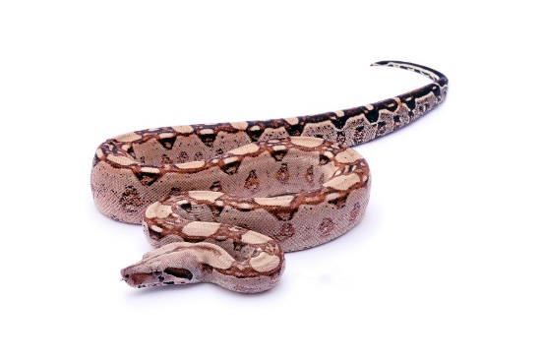
Carnivore
Herbivore
Carnivore
I eat smaller insects and arachnids – even other scorpions.
I eat grass and meadow plants.
I eat rodents, small animals, sometimes other snakes.
NEXT SLIDE

Slide 19
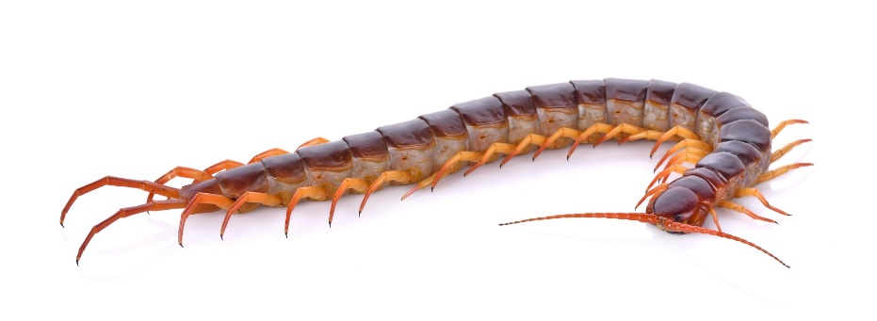
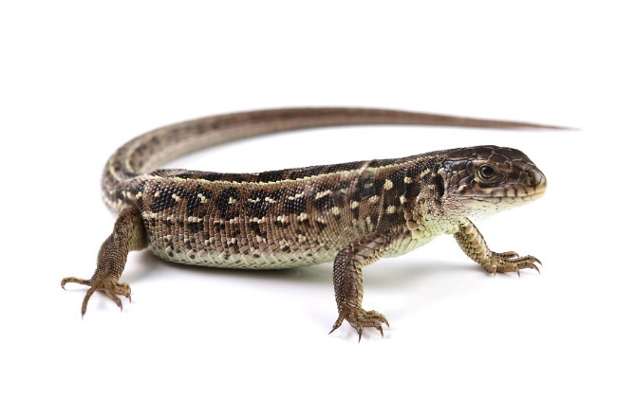
Carnivore
Carnivore
Detritivore
I eat smaller insects and arachnids, if I am big enough I can eat small mammals, snakes and even bats.
I eat small insects.
I eat rotting wood, fallen fruit, leaves, dead bodies and poo.
NEXT SLIDE

Slide 20
How did you do? How many points did you get? Now you should know all about:
Carnivores and what they eat
Herbivores and what they eat
Omnivores and what they eat
Detritivores and what they eat
What predators are and how they are adapted to eat and survive
What prey animals are and how they are adapted to eat and survive

